Slide 2
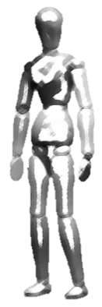
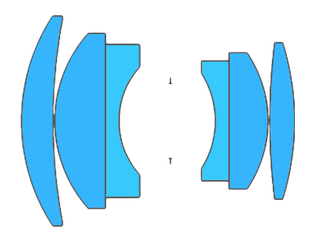
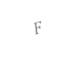
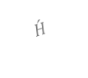
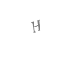
We can orient the plane of sharp focus & the DOF in Scheimpflug camera,
approximated as a wedge,
Depth of field (DOF)
$$F$$
$$\acute{H}$$
$$H$$
Sensor
Optical axis
Plane of sharp focus (PoSF)
Notes:
Now that we know how to orient the plane of sharp focus along a desired orientation,
NOTE: I think that the wedge approximation is true for a set spatial frequency limit on the image plane …. However, if we desire a target spatial frequency in the object space, then the region is not really a wedge extending away from the camera, …. But the shape shrinks as we go from the camera.

Slide 3
Synthesis of extended DOF in traditional photography using focus stacking
Depth of Field
Depth of Field
Depth of Field
Depth of Field
Depth of Field
DEEP OBJECT SPACE
Sensor
Sensor
Sensor
Sensor
Sensor
Plane of sharp focus
Plane of sharp focus
Plane of sharp focus
Plane of sharp focus
Plane of sharp focus
Notes:
In fact there is a similar technique in conventional photography, called focus stacking.

Slide 4
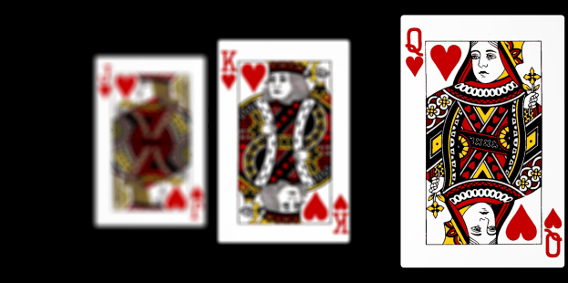
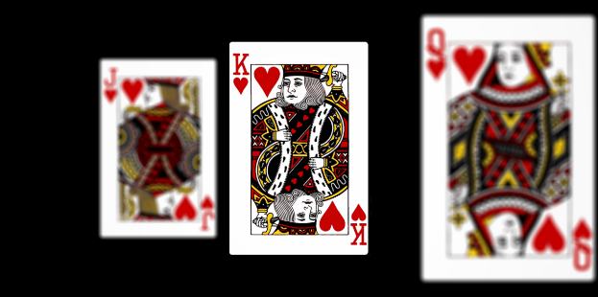



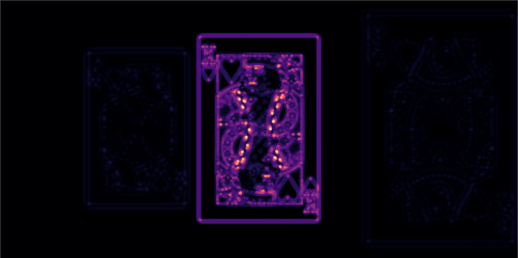
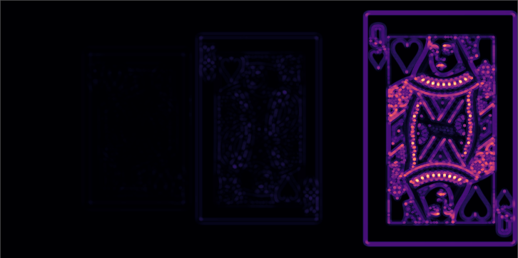

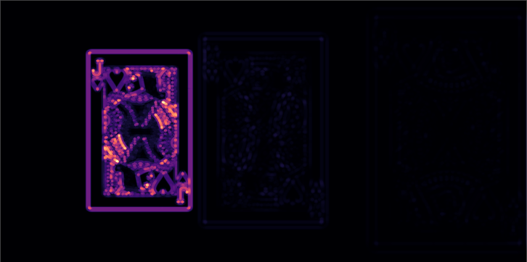
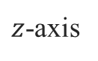
Synthesis of extended DOF in traditional photography using focus stacking
Sensor image 1/3
Sensor image 2/3
Sensor image 3/3
Lens
64 mm
$z$-axis
Sensor plane
Focus measure (LoG)
Focus measure (LoG)
89 mm
200 mm
Focus measure (LoG)
200 mm
1000 mm

Slide 5
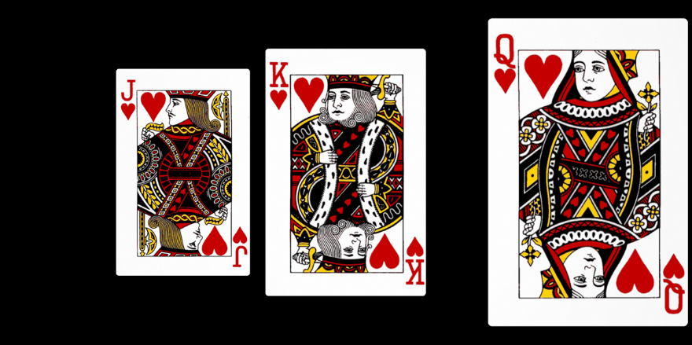
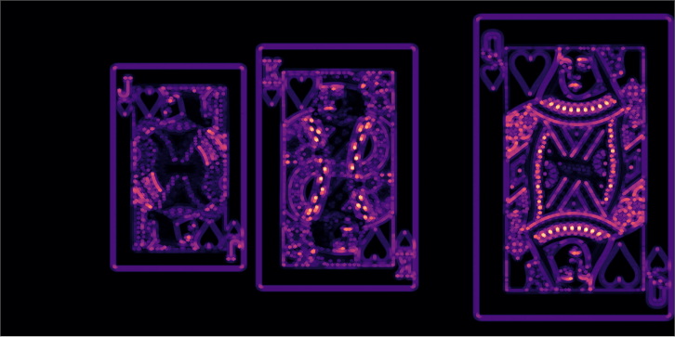
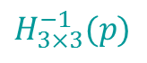
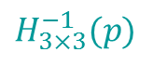
Synthesis of extended DOF in traditional photography using focus stacking
Registration
Blending
Composite image
$$H_{3×3}^{−1}(p)$$
$$H_{3×3}^{−1}(p)$$
Focus measure (LoG)

Slide 6
So here is the idea …
Plane of sharp focus
Plane of sharp focus
Plane of sharp focus
Plane of sharp focus
Plane of sharp focus
DEEP OBJECT SPACE
Sensor

Slide 7
Notes:
[Blank] But I began to wonder, why doesn’t such a method already exist?

Slide 8
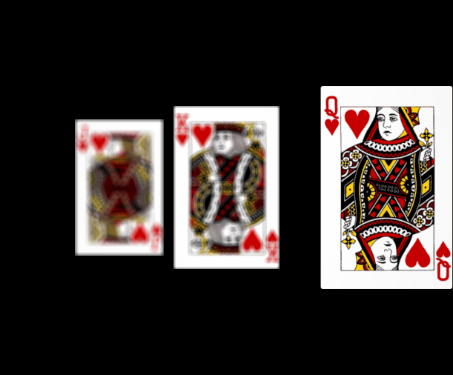
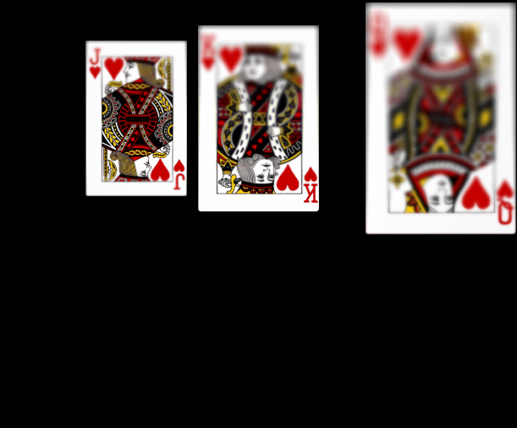
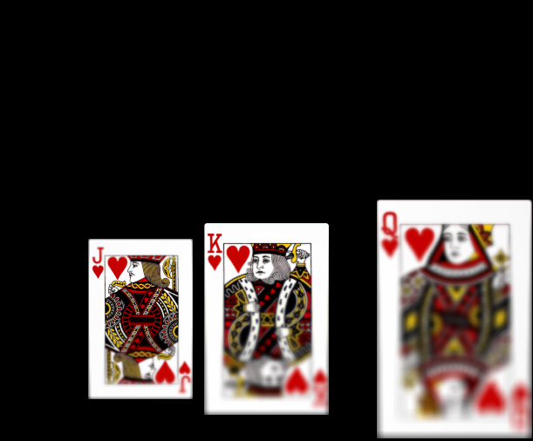
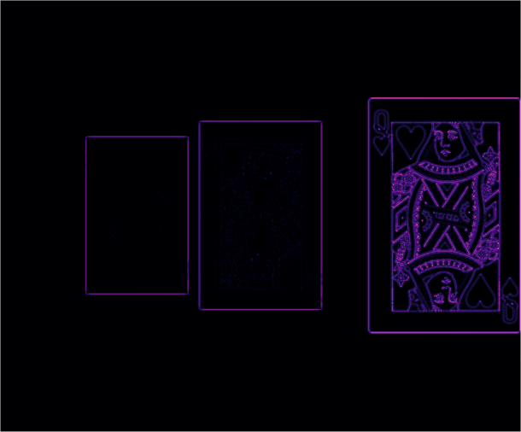
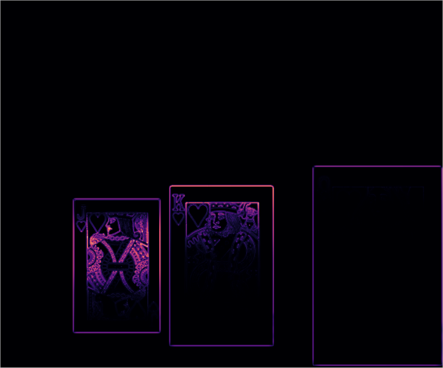
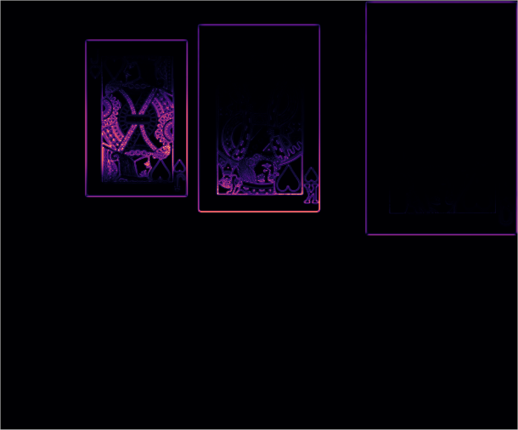
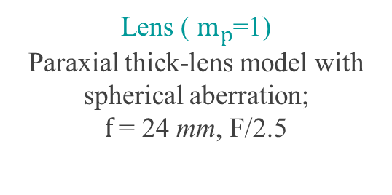


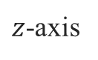

Setup of Zemax simulation to verify the theory of angular focus stacking (AFS) to extend the DOF
Lens rotated by 0° about ENPP
Lens rotated by -$α$° about ENPP
Lens rotated by $α$° about ENPP
Sensor image 1/13 ( 0°)
Sensor image 7/13 ( -8°)
Sensor image 13/13 (8°)
Lens ( $m_{p}$=1)
Paraxial thick-lens model with spherical aberration;
$f$ = 24 mm, F/2.5
Lens ( $m_{p}$=1)
Paraxial thick-lens model with spherical aberration;
$f$ = 24 mm, F/2.5
Setup
Lens ( $m_{p}$=1)
Paraxial thick-lens model with spherical aberration;
$f$ = 24 mm, F/2.5
Setup
Setup
1/2
1/2
1/2
64 mm
64 mm
64 mm
$z$-axis
$z$-axis
$z$-axis
Sensor plane
Sensor plane
Sensor plane
6 x 5 sq. mm, 1.78 $μm$
6 x 5 sq. mm, 1.78 $μm$
6 x 5 sq. mm, 1.78 $μm$
89 mm
89 mm
89 mm
200 mm
200 mm
200 mm
1/2
1/2
1/2
1000 mm
1000 mm
200 mm
1000 mm
200 mm
200 mm
Focus measure (LoG)
Focus measure (LoG)
Focus measure (LoG)

Slide 9
The inter-image homography is the geometric mapping between corresponding points in the images in the angular focal stack
Sensor image 1/13 ( 0°)
Sensor image 7/13 ( -8°)
?
1/2
1/2
Notes:
The question that we are interested in asking is how is one image geometrically related to another image in the stack?
… we found out that such a relation exist only if the lens is rotated about the center of the entrance pupil. Furthermore, if the pupil magnification is unity, then

Slide 10
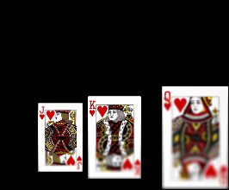
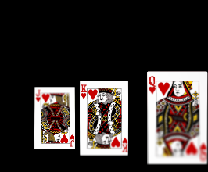
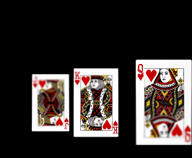
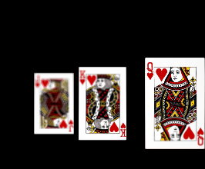
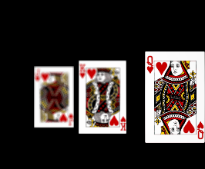
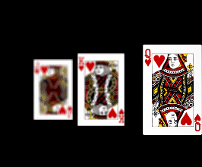
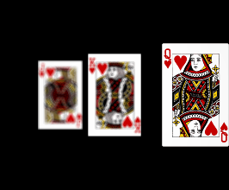
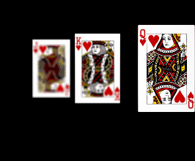
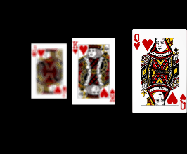
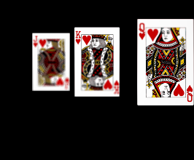
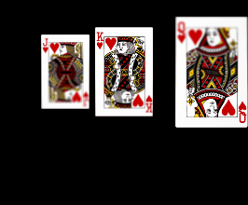
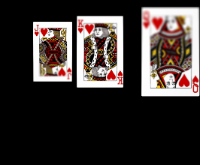

The focal stack of 13 images for lens tilts between -8° and 8°
Refrence image

Slide 11
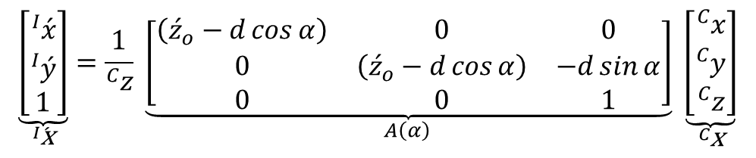
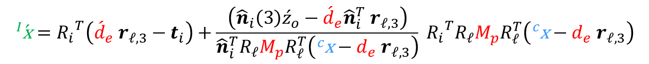
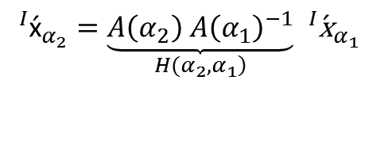
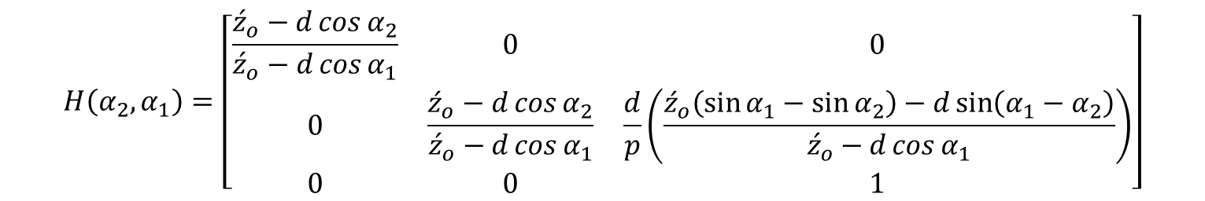
The inter-image homography is the geometric mapping between corresponding points in the images in the angular focal stack
$$\begin{aligned}{}_{ }^{I}{\acute{\text{x}}}=&{R_{i}}^{T}\left({\acute{d}}_{e} r_{𝓁,3}−t_{i}\right)+\frac{\left({\hat{n}}_{i}\left(3\right){\acute{z}}_{o}−{\acute{d}}_{e}{\hat{n}}_{i}^{T} r_{𝓁,3}\right)}{{\hat{n}}_{i}^{T}R_{𝓁}M_{p}R_{𝓁}^{T}\left({}_{ }^{c}{\text{x}}−d_{e} r_{𝓁,3}\right)}{}_{ }^{ }{{R_{i}}^{T}R_{𝓁}}M_{p}R_{𝓁}^{T}\left({}_{ }^{c}{\text{x}}−d_{e} r_{𝓁,3}\right)\end{aligned}$$
4
For roation of a unit pupil magnification lens about the $x$-axis by angle $α$
$$\underset{{}_{ }^{I}{\acute{\text{x}}}}{\underbrace{\left[\begin{matrix}{}_{ }^{I}{\acute{x}} \\ {}_{ }^{I}{\acute{y}} \\ 1\end{matrix}\right]}}=\underset{ A\left(α\right)}{\frac{1}{{}_{ }^{C}z} \underbrace{\left[\begin{matrix}\left({\acute{z}}_{o}−d\cos{α}\right) & 0 & 0 \\ 0 & \left({\acute{z}}_{o}−d\cos{α}\right) & −d\sin{α} \\ 0 & 0 & 1\end{matrix}\right]}} \underset{{}_{ }^{C}{\text{x}}}{\underbrace{\left[\begin{matrix}{}_{ }^{C}x \\ {}_{ }^{C}y \\ {}_{ }^{C}z\end{matrix}\right]}}$$
8
Two images obtained under lens rotations $α_{1}$ and $α_{2}$ can be related as:
$${{}_{ }^{I}{\acute{\text{x}}}}_{α_{2}}=\underset{\left.H(α_{2}, α_{1}\right)}{\underbrace{A\left(α_{2}\right) {A\left(α_{1}\right)}^{−1}}}{ {}_{ }^{I}{\acute{\text{x}}}}_{α_{1}}$$
9
$$H\left(α_{2},α_{1}\right)=\left[\begin{matrix}\frac{{\acute{z}}_{o}−d\cos{α_{2}}}{{\acute{z}}_{o}−d\cos{α_{1}}} & 0 & 0 \\ 0 & \frac{{\acute{z}}_{o}−d\cos{α_{2}}}{{\acute{z}}_{o}−d\cos{α_{1}}} & \frac{d}{p}\left(\frac{{\acute{z}}_{o}\left(\sin{α_{1}}−\sin{α_{2}}\right)−d\sin\left(α_{1}−α_{2}\right)}{{\acute{z}}_{o}−d\cos{α_{1}}}\right) \\ 0 & 0 & 1\end{matrix}\right]$$
10
Notes:
The question that we are interested in asking is how is one image geometrically related to another image in the stack?
… this is called the inter-image homography.
We found out that such a relation—the inter-image homography—exist only if the lens is rotated about the center of the entrance pupil. Furthermore, if the pupil magnification is one, then the transformation greatly simplifies to a simple scaling and transverse shift.

Slide 12

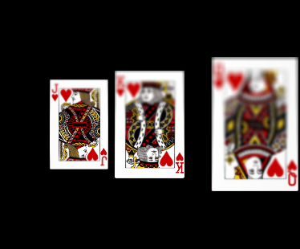
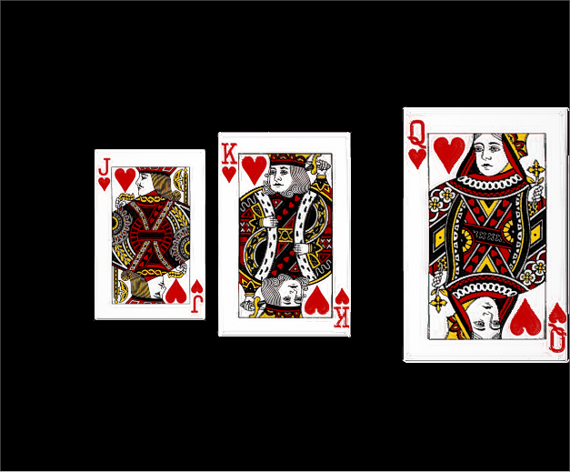
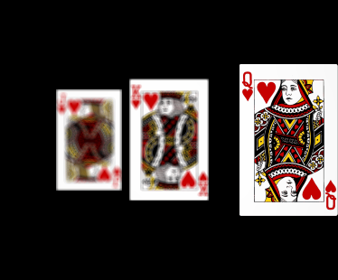
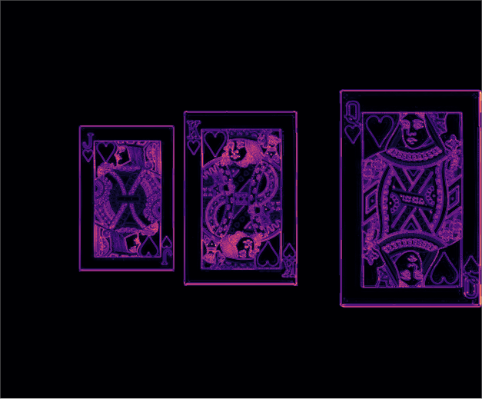

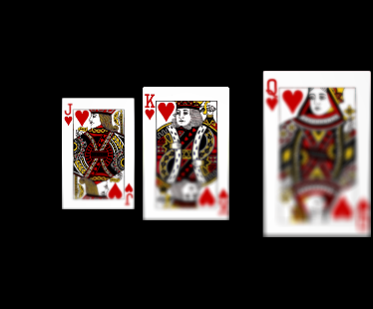

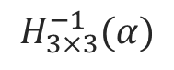



The composite image shows all the planes in sharp focus
Registration
Blending
Composite image
$$H_{3×3}^{−1}(α)$$
$$⋮$$
$$⋮$$
Focus measure (LoG)
$$⋮$$
$$⋮$$
$$H_{3×3}^{−1}(α)$$

Slide 13



Depth of field (DOF) in Scheimpflug camera
$$F$$
$$\acute{H}$$
$$H$$
Sensor
Depth of field (DOF)
Optical axis
Plane of sharp focus (PoSF)
Hinge line
[Merklinger, H. M. (1996). Focusing the view camera.]

Slide 14
Depth of field (DOF)
Sensor
Optical axis
Plane of sharp focus (PoSF)

Slide 15
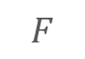
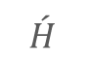

The DOF in traditional camera extends towards infinity in the directions
orthogonal to the optical axis, and beyond the field of view
Plane of sharp focus
$$F$$
$$\acute{H}$$
$$H$$
Field of view
Optical axis
Sensor
Depth of field (DOF)
Notes:
NOTE: I think that the wedge approximation is true for a set spatial frequency limit on the image plane …. However, if we desire a target spatial frequency in the object space, then the region is not really a wedge extending away from the camera, …. But the shape shrinks as we go from the camera. So would it be fair to suggest that the exact nature of the DOF depends on a set definition?

Slide 16
Plane of sharp focus (PoSF)
Optical axis
Sensor
Depth of field (DOF)
Notes:
… in fact there is axactly a

